Slide 1



Conferenza Italiana degli Sviluppatori 2018
Imola circuit
Oct 11th 2018
Notes:
Company doing well FY16 very good year+10% EBIT 18%
Our job – anticipate your needs
Consumer IT
Mobile apps
Mobile Enterprise Apps
Web site becomes Web app
Web apps & Mobile apps converge
SAGE 10€/month, Why ? Xero eating their lunch!
Security
Cloud

Slide 2
Agenda
09:30 – Registrazione
09:45 – Benvenuto
a cura di Marco Colli – Sales & Marketing Manager Four Js Italia
10:00 – Genero Enterprise roadmap 2018-2021
a cura di Bryn Jenkins – COO Four JS
10:30 – Genero Enterprise 3.20, novità e roadmap
a cura di Olivier Imbert – Four Js Strasburgo
11:30 – Genero Studio e Report Writer 3.2, novità e roadmap
a cura di Christophe Meyer – Four Js Strasburgo
12:30 – Q&A
12:45 – Lunch
Notes:
Today code is slightly different
We didn’t implement all features in each environment
We will close the gap
( Input Array, Tables, Trees & Parallel Dialogs)
Fully functional Stack Layout
Reinforce cross-platform message: « You focus on business logic, we take care of the infrastructure »
Google: AI, image recognition and voice commands

Slide 3
Bravi Manager Bravi
Si immagina che la digitalizzazione e l’industria 4.0 tocchi tutti in modo indiscriminato, invece la percezione dell’impatto della digitalizzazione sul business è differente tra chi se ne deve occupare direttamente e chi è toccato in modo più indiretto. Il divario tra importanza ed adozione rivela che il livello di urgenza è recepito in modo diverso tra i vari settori. Su questi temi è sempre in agguato la morale de “la Volpe e l’uva” di Esopo: è fin troppo facile sostenere che ciò che facciamo meno sia poco importante. ( Ricerca Ambrosetti )
"Solo il 3% delle imprese italiane ha operato in modo compiuto la transizione digitale", mentre "ben il 63% si dice indifferente" ai vantaggi dell'innovazione. Lo ha detto il presidente dell'Istat, Giorgio Alleva, illustrando nel corso di un convegno sulla banda larga all'Agcom lo studio "Il ruolo dei dati nello sviluppo digitale in Italia".
Notes:
Today code is slightly different
We didn’t implement all features in each environment
We will close the gap
( Input Array, Tables, Trees & Parallel Dialogs)
Fully functional Stack Layout
Reinforce cross-platform message: « You focus on business logic, we take care of the infrastructure »
Google: AI, image recognition and voice commands

Slide 4












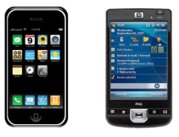










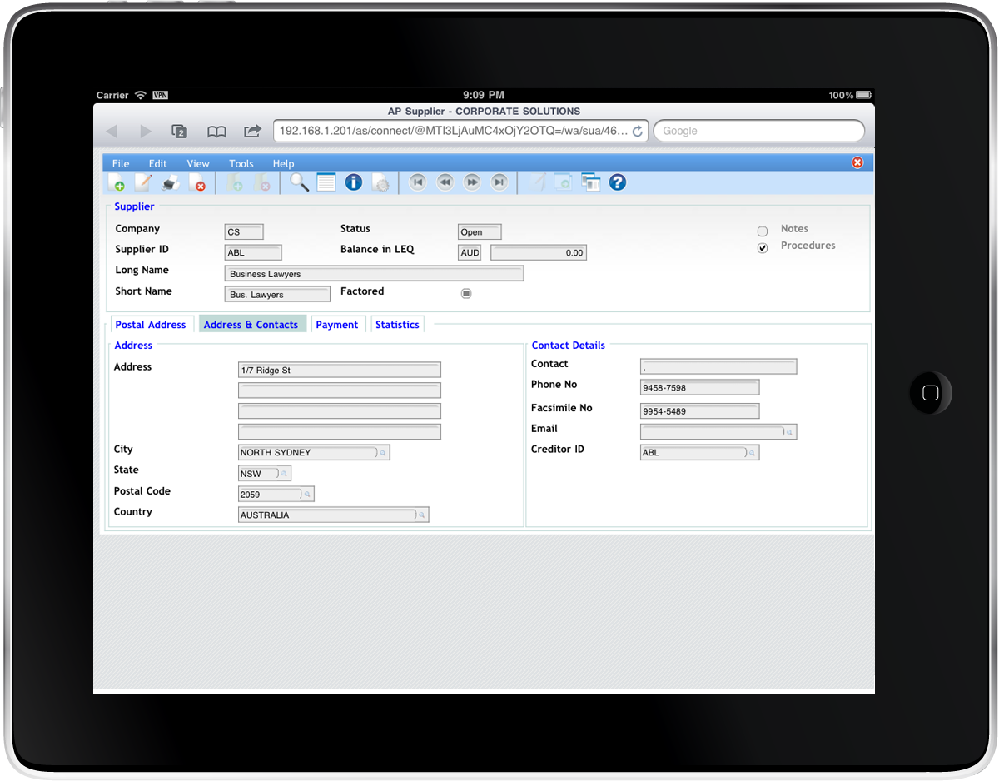


Cross platform
Thin client, server-side integration, security & scalability
IoT
Application Server
Database Server
Desktop
Client
Firewall
Mobile
Web Server
App Server
Web
Browser
GAS
Notes:
You get a better idea of the cross-platform versatility of Genero in this diagram.
Here you can see how we can create an n-tier architecture that is both scalable and secure.
The business logic can be distributed across multiple servers behind the firewall. This protects the application from virus intrusion or hackers. Only the data displayed in the User Interface display form penetrates the firewall.
The Genero Desktop Client supports Windows, Linux and Mac OSX.
The Genero Web Client supports browsers, smartphones and tablets.
And on the back-end …
Genero supports all the leading database brands. The majority of our customers chose Informix for its superior technology and performance. But there are times when customer purchasing departments impose other brands. And we support those too.
I don’t know of any other develoment environment that encompasses that landscape with a single product, a single compilation, a single binary.

Slide 5






FourJs Italia
Presenti in Italia sin dal 2002
Strumento leader nello sviluppo di applicazioni per i mercati Automotive, Healtcare, Retail, Industry, Logistics
Un team Italiano composto da 6 persone
  Formalmente una divisione di Reweb Srl
Notes:
Today code is slightly different
We didn’t implement all features in each environment
We will close the gap
( Input Array, Tables, Trees & Parallel Dialogs)
Fully functional Stack Layout
Reinforce cross-platform message: « You focus on business logic, we take care of the infrastructure »
Google: AI, image recognition and voice commands

Slide 6
Servizi a disposizione dei partners
Formazione
Affiancamento progettuale
Supporto alla migrazione da codice 4GL
Attivita Marketing congiunte
Programmi commerciali riservati (Share revenue, OEM)
Notes:
Today code is slightly different
We didn’t implement all features in each environment
We will close the gap
( Input Array, Tables, Trees & Parallel Dialogs)
Fully functional Stack Layout
Reinforce cross-platform message: « You focus on business logic, we take care of the infrastructure »
Google: AI, image recognition and voice commands

Slide 7
Il portale web
Sito in Italiano (parte) http://4js.com/?tbLang=italian
Registrazione https://4js.com/account/create/
  Download / Products: download the latest versions of the products*,
  Download / Early Access Programs: test the early versions of the products*,
  Support / FAQ: view and rate all the entries of the technical FAQ**,
  Support / Forum: take part in all customer discussions**, and receive by e-mail new products announcement and important information,
  Support / Issue tracker: browse the product issues database*.
Notes:
Today code is slightly different
We didn’t implement all features in each environment
We will close the gap
( Input Array, Tables, Trees & Parallel Dialogs)
Fully functional Stack Layout
Reinforce cross-platform message: « You focus on business logic, we take care of the infrastructure »
Google: AI, image recognition and voice commands

Slide 8
Buon lavoro
Notes:
Today code is slightly different
We didn’t implement all features in each environment
We will close the gap
( Input Array, Tables, Trees & Parallel Dialogs)
Fully functional Stack Layout
Reinforce cross-platform message: « You focus on business logic, we take care of the infrastructure »
Google: AI, image recognition and voice commands

