Slide 1


ITDC
Developer Conference
Our Vision
Bryn Jenkins
Autodromo Internazionale
Enzo e Dino Ferrari
11 October 2018
Notes:
WELCOME TO OUR ANNUAL FAMILY REUNION
LIKE TO TAKE YOU THROUGH ROADMAP
AND VISION
AND THE CONTEXT THAT CREATED IT
THEN GO INTO THE DETAIL
BUT FIRST

Slide 2
3 million users
Double digit growth
12% EBIT
Notes:
REPORT ON HOW WE ARE DOING
4GL IS LIKE COBOL
2017 WAS A GREAT YEAR
ABOUT TO SHIP OVER 3 MILLIONTH USER
DOUBLE DIGIT $ GROWTH
VERY PROFITABLE - 12% WEAK DOLLAR (16% CONSTANT $)
¾ 2018 – LOOKING GOOD

Slide 3

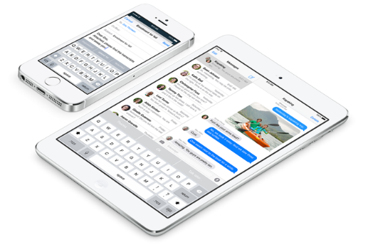


















The post-PC era – Consumer IT
The 5 big technology shifts
Touch
UI
UX
User Experience
GUI
Next-Gen
Mobile
IT
Delivery
Data
Center
Cloud
PC
Browser
Information
& Communications
e-mail
Social Media
CMS/DMS
Innovation
& Usage Model
Consumer
Enterprise
BIG Data
& Analytics
Data
Relational Database
& BI
Source:
Notes:
TAKE YOU BACK TO 2014
CONSUMER IT – FIRST TIME CONSUMERS DRIVING IT REVOLUTION
5 TECH SHIFTS…
INTUITIVE TACTILE UX
APP CLOUD DELIVERY IN BROWSERS
SOCIAL MEDIA MESSAGING/INFLUENCE/COMMERCE
BIG DATA – HEATWAVE = ICE CREAM INVENTORY
YOUR CHALLENGE: STAY RELEVANT

Slide 4
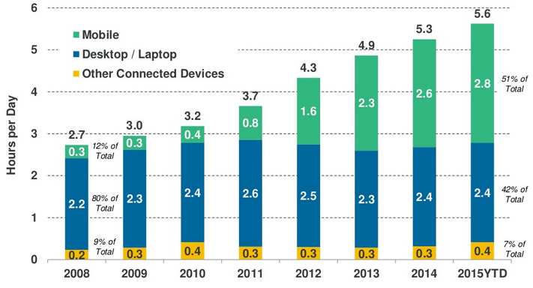

Industry trends
The way we work is being transformed
Time spent per adult per day with digital media,
USA 2008 - 2015
Source:
Notes:
WE R LEAVING INTEL/MICROSOFT HEGEMONY
IS THAT JUST HYPE?
APPEARS NOT
LEADING VC SURVEY
ADULTS SPEND MORE TIME ON MOBILE
THAN BEHIND A DESKTOP OR LAPTOP SCREEN
SMARTPHONES ARE A SOCIAL PHENOMENON
CONSUMER THROUGH MOBILE SETTING IT AGENDA.

Slide 5
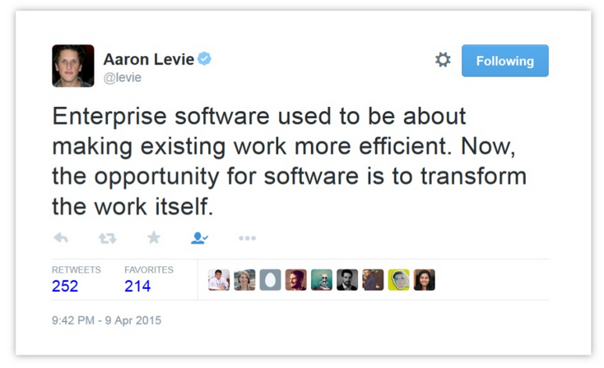
Industry trends
The way we work is being transformed
Aaron Levie, CEO Box, Cloud storage start-up
Notes:
QUOTE I LIKE FROM AARON LEVIE
CEO BOX, CLOUD STORAGE START-UP
PAST:
S/W MADE EXISTING WORK MORE EFFFICIENT
NOW:
S/W TRANSFORMING THE WORK ITSELF
ASK YOURSELVES:
IS MY STRATEGY TO TRANSFORM THE WAY I INTERACT?

Slide 6
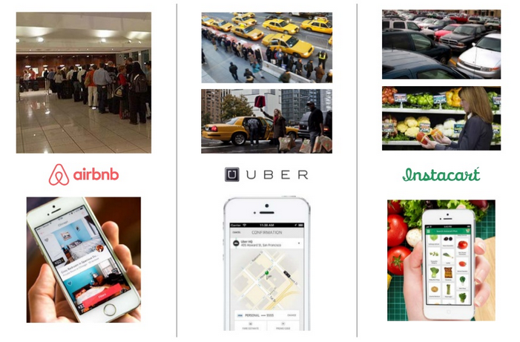
Industry trends
Innovation in weak user experience markets
Notes:
SHOW YOU WHAT I MEAN
LEADING DISRUPTIVE PLATFORMS
IF YOU LOOK AT THIS SLIDE
« NONE OF THIS APPLIES TO ME! »
« ORANGE FLAG » FOR YOUR SURVIVAL PROSPECTS
MAYBE EVEN A « RED FLAG »

Slide 7

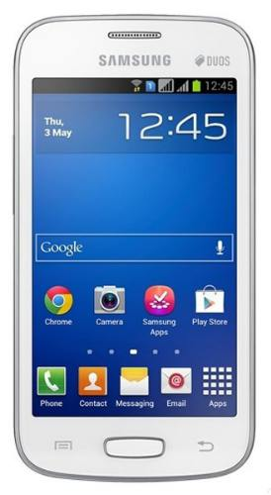
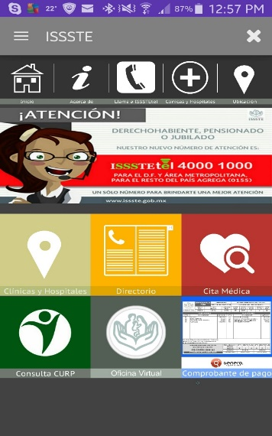
Digital transformation
Healthcare
THEN
NOW
Notes:
OUR CUSTOMERS HAVE STARTED
TRANSFORMING THE WAY PEOPLE WORK
ISSSTE – HEALTHCARE
BEFORE: DOCTOR APPT BY PHONE
NOW IF NEED HELP
ALSO RETIREMENT ACCOUNTS
DIGITAL TRANSFORMATION
HUGE COST SAVINGS
PAPER, INK, STAMPS, PRINTERS

Slide 8
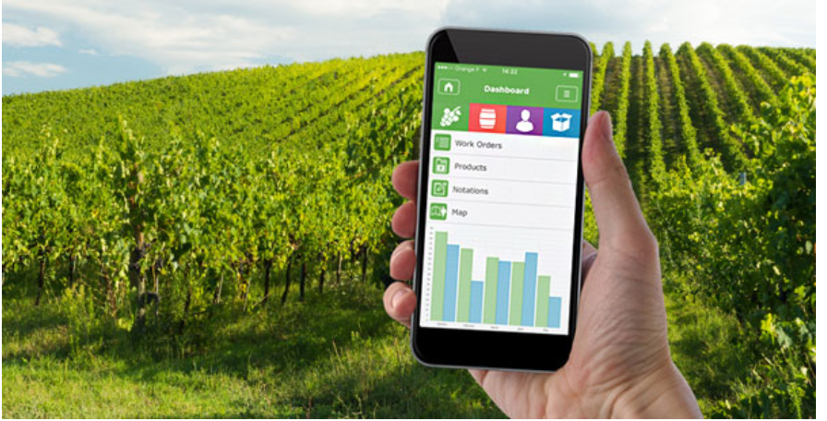
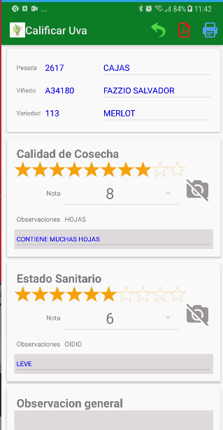
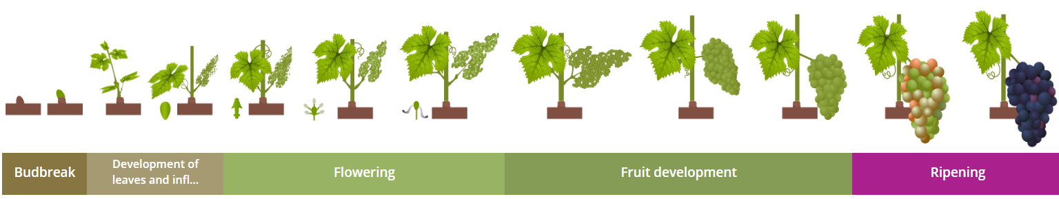
Digital transformation
Chandon – Vineyard precision management
Notes:
CHANDON ARGENTINA
BEST ARGENTINEAN WINES
PRECISION VITICULTURE
GENERO MOBILE

Slide 9
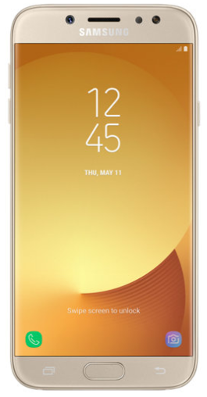
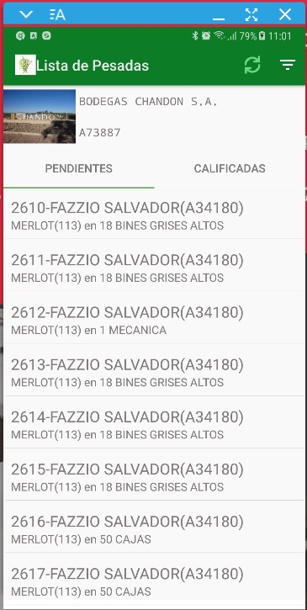
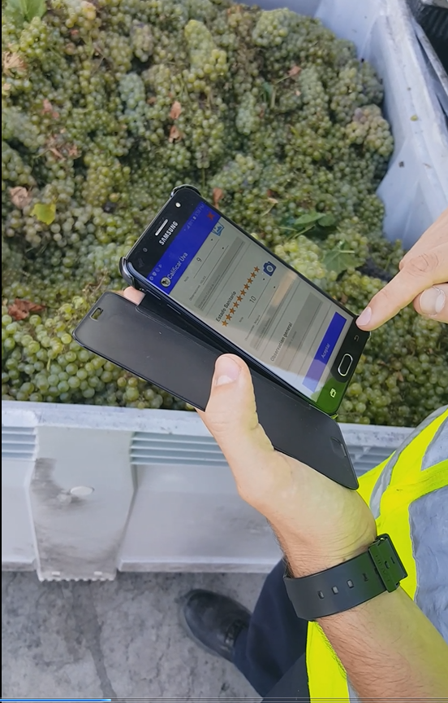
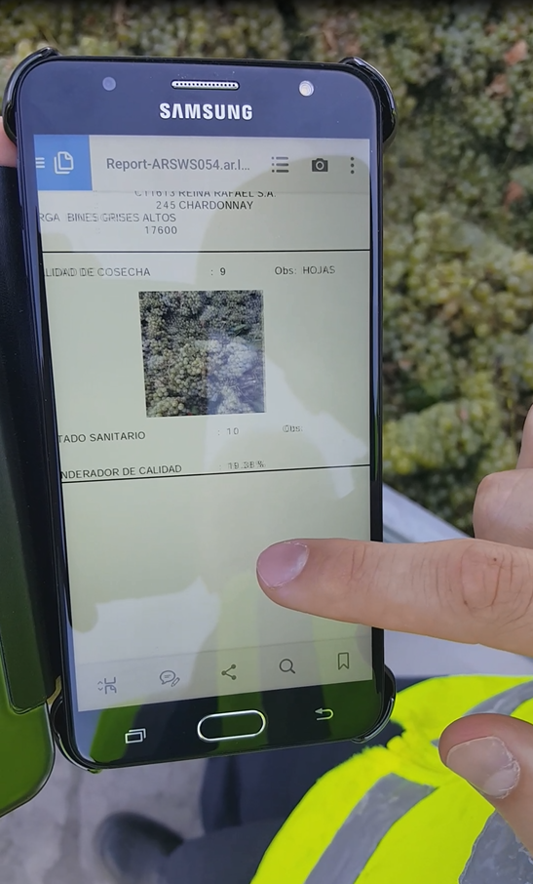
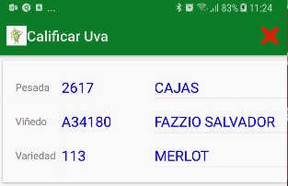
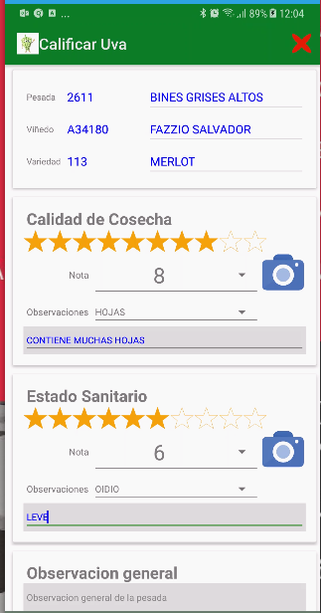
Digital transformation
Chandon – Vineyard precision management
Notes:
IoT DEVICES READING SOIL CONDITIONS
HUMIDITY
ACIDITY
EVERY VINE
SINESI HERE IN ITALY TOO

Slide 10
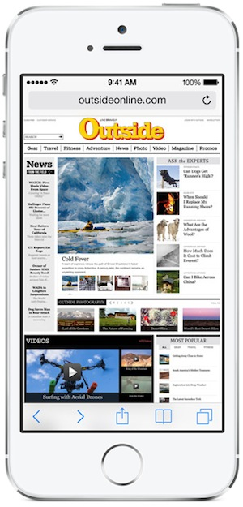
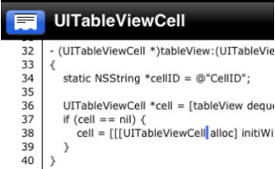
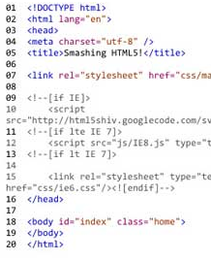




Application types
Native
HTML5
Hybrid
Native code
Mobile browser
Web view container
Notes:
3 WAYS TO DEVELOP MOBILE APP
NOTICE: WEB SITES LOOKING MORE LIKE APPS
APPS LOOKING MORE LIKE WEB SITES
ARCHITECTURE DEPENDS ON AUDIENCE
WHAT’S IMPORTANT?
UX? ON-LINE/OFF-LINE? COST? TIME2MKT?
Natively – highest cost, best results, speed and user experience. Offline. But reinventing the wheel.
HTML5 – lower cost, compromise UI and speed, cross-platform support, but no sensor or app support. Online.
HYBRID – lower cost, faster time to market, best of both worlds. Online/offline.
What’s missing is a tool that provides best of both native and hybrid worlds.

Slide 11
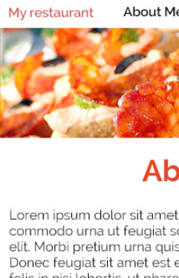
Industry trends
Web-like apps and app-like websites
Notes:
AND IF YOU CHOOSE WEB APIS
FOR PORTABILITY & COST
THINK ABOUT FORM FACTORS
OUR MISSION
ONE APP RUNS EVERYWHERE
NOT QUITE THERE YET

Slide 12
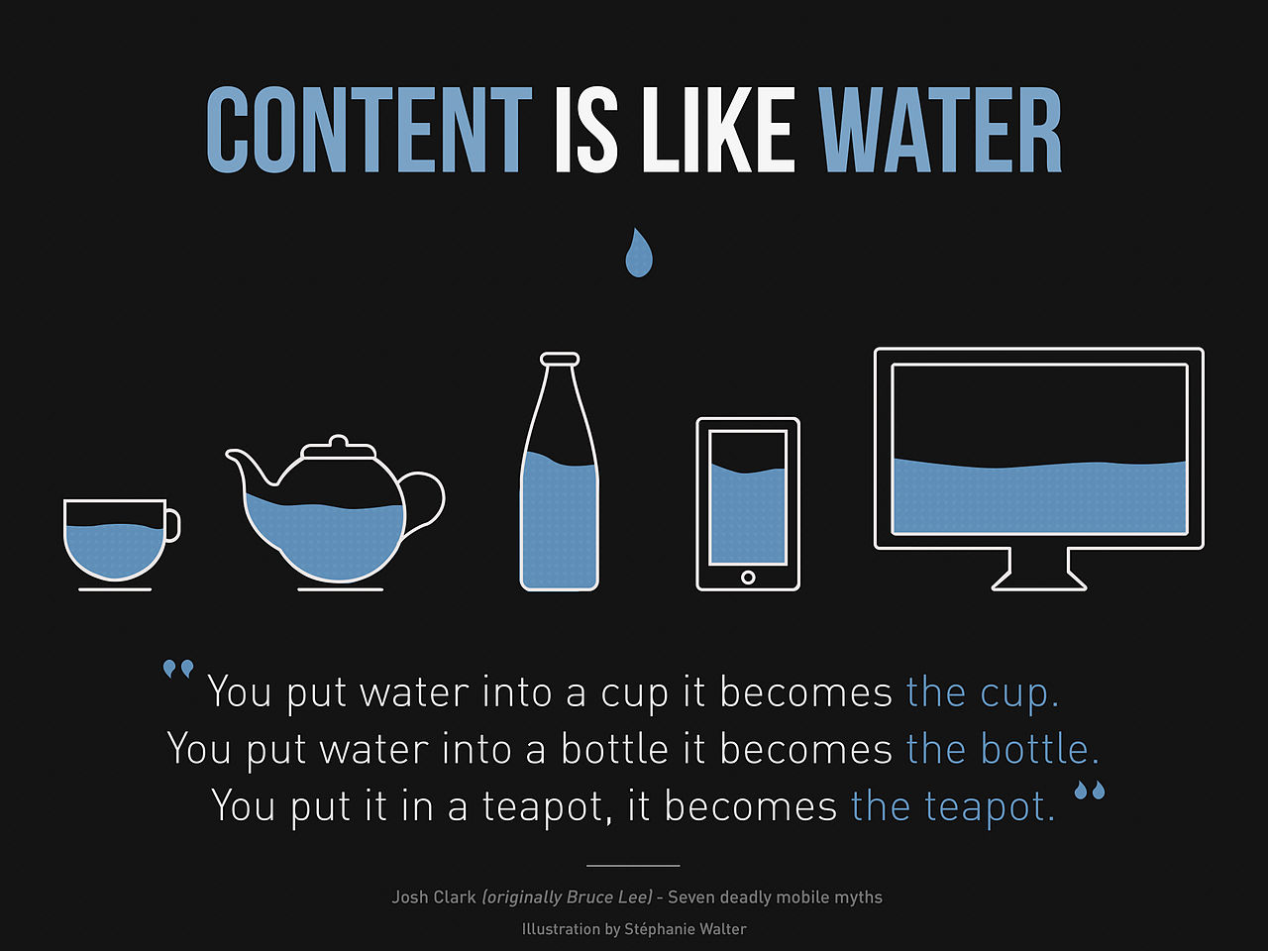
Notes:
NEW WORLD OF CONSUMER IT
APPS TREAT CONTENT LIKE WATER
THE VIEWPORT (WINDOW) NEEDS TO ADAPT
SO APP PRESENTS PROPERLY
NO MATTER WHAT DEVICE / ORIENTATION

Slide 13
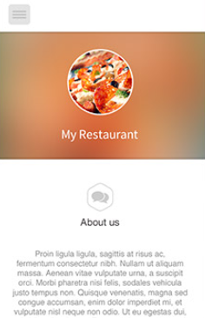
Industry trends
Web-like apps and app-like websites
Notes:
THE TERM FOR THIS
« RESPONSIVE DESIGN »
APPLIES REALLY TO WEB SITES
AND WEB TECHNOLOGIES
BUT WOULDN’T IT BE NICE…

Slide 14

Industry trends
What is Responsive Design?
Notes:
APP ADAPTS TO DEVICE
FIRST FOR BIZ APPS
THIS IS THE DIRECTION WE R HEADED
IT IS AMBITIOUS
WORTHY CAUSE

Slide 15




ROADMAP
FY18-21
2021
vNEXT++
vNext++ - “Table Subgroups”
GA MARCH 2021
EAP DECEMBER 2020
Table subgroups
  Grouping
    BEFORE/AFTER group aggregates
    Collapsible groups
2020
vNEXT+
vNext+ - “Responsive Layouts”
GA MARCH 2020
EAP DECEMBER 2019
  Fully functional STACK layout
    Alternative to GRID w/o feature loss
    Simple
    Predictable
    Platform independent
    Greater UI abstraction
Cloud Services
  Report Writer Online
  Dashboards
  (Drill down links)
  Interactive charts
vNext – “Universal Rendering”
Reconciling the Desktop & Mobile
GA MARCH 2019
EAP DECEMBER 2018
GDC/GBC/GM client feature reconciliation
    GDC/GBC : Parallel Dialogs
    GMI/GMA :
      TABLEs, TREEs, INPUT ARRAYs, Multi-Row Select
  GMI/GMA on-going Cordova ‘plug-in’ integration
Studio & developer productivity
  Code convention tools
  Enhanced Business Application Modeller
    Events (custom code)
    Dynamic UI
  Remote development with file synchronization
2019
vNEXT
Language modernization
  Case sensitive
  Named parameters
  Auto indentation
  Anyrecord generic type
  Function parameters by reference
Notes:
PUBLISHED ON WEB SITE
INTO FIRST YEAR
FIRST WE NEED TO RECONCILE DESKTOP & MOBILE
CLOSE LANGUAGE GAP
UNIVERSAL RENDERING
GDC: PARALLEL DIALOGS
GM: TABLES, TRESS, INPUT ARRAYS
vNEXT+ RESPONSIVE DESIGN
FULLY FUNCTIONAL STACK LAYOUT
vNEXT++ TABLE SUBGROUPS
COLLAPSIBLE GROUPS
BEFORE AFTER GROUP AGGREGATES

Slide 16
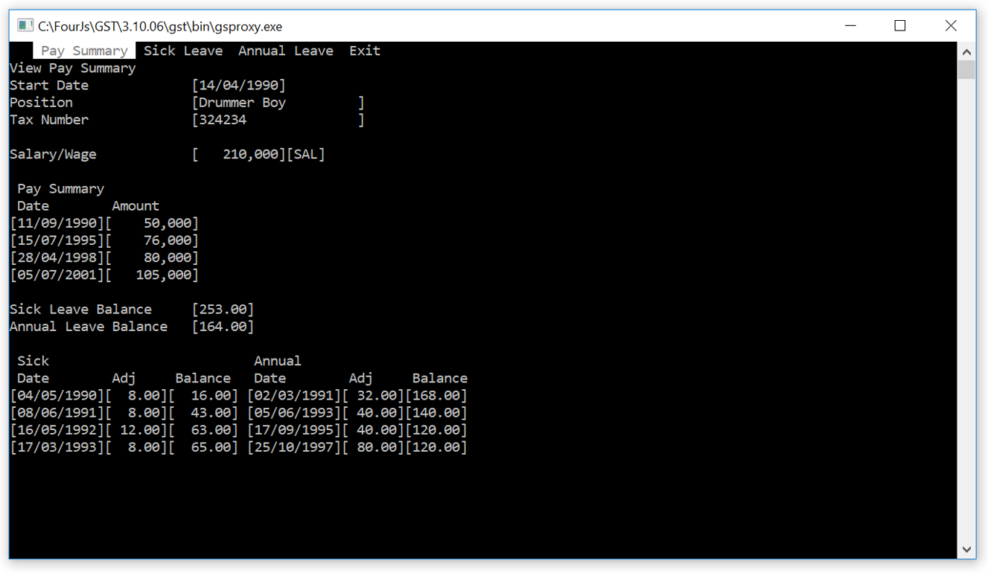
Notes:
WE HAVE COME FROM THIS
TO THIS

Slide 17
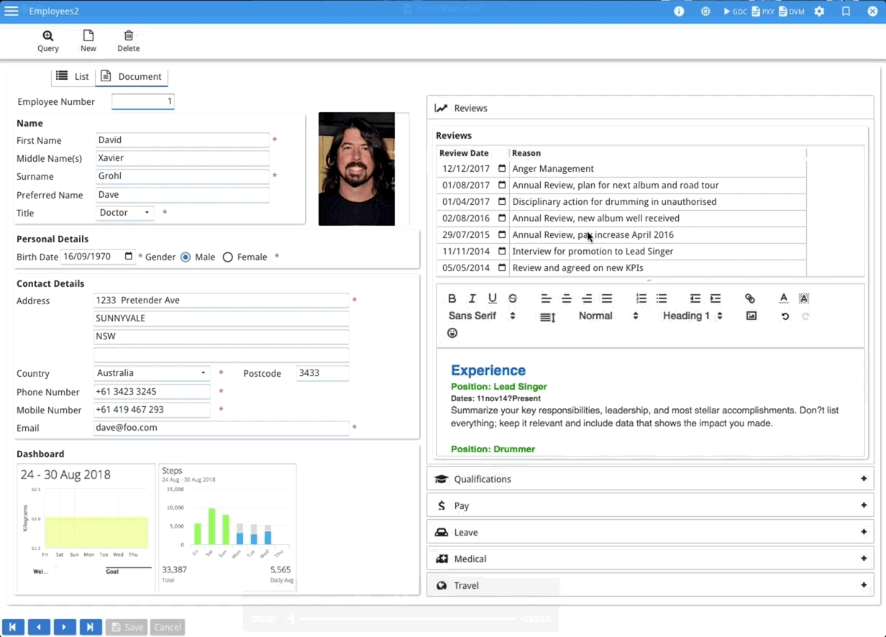
Notes:
BETWEEN THOSE 2 SCREENS
SAME BUSINESS LOGIC
THE CODE DIDN’T CHANGE
FOLDERS & ACCORDION STYLE
I KNOW WHAT U R THINKING
DON’T HAVE TIME
CAN’T FIND PEOPLE
YET SO CRITICAL

Slide 18

THANK YOU!
Notes:
HAVE A GREAT CONFERENCE

